Slide 1
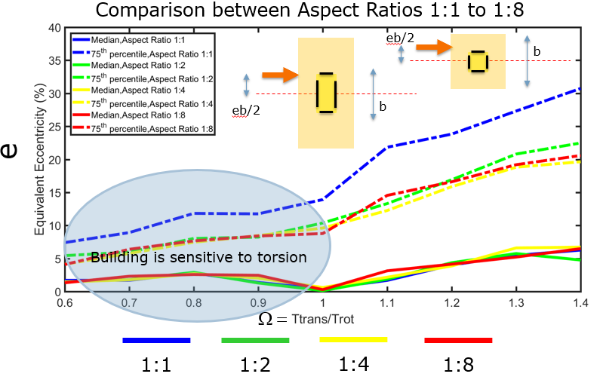
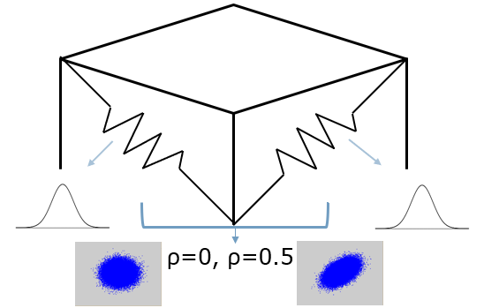
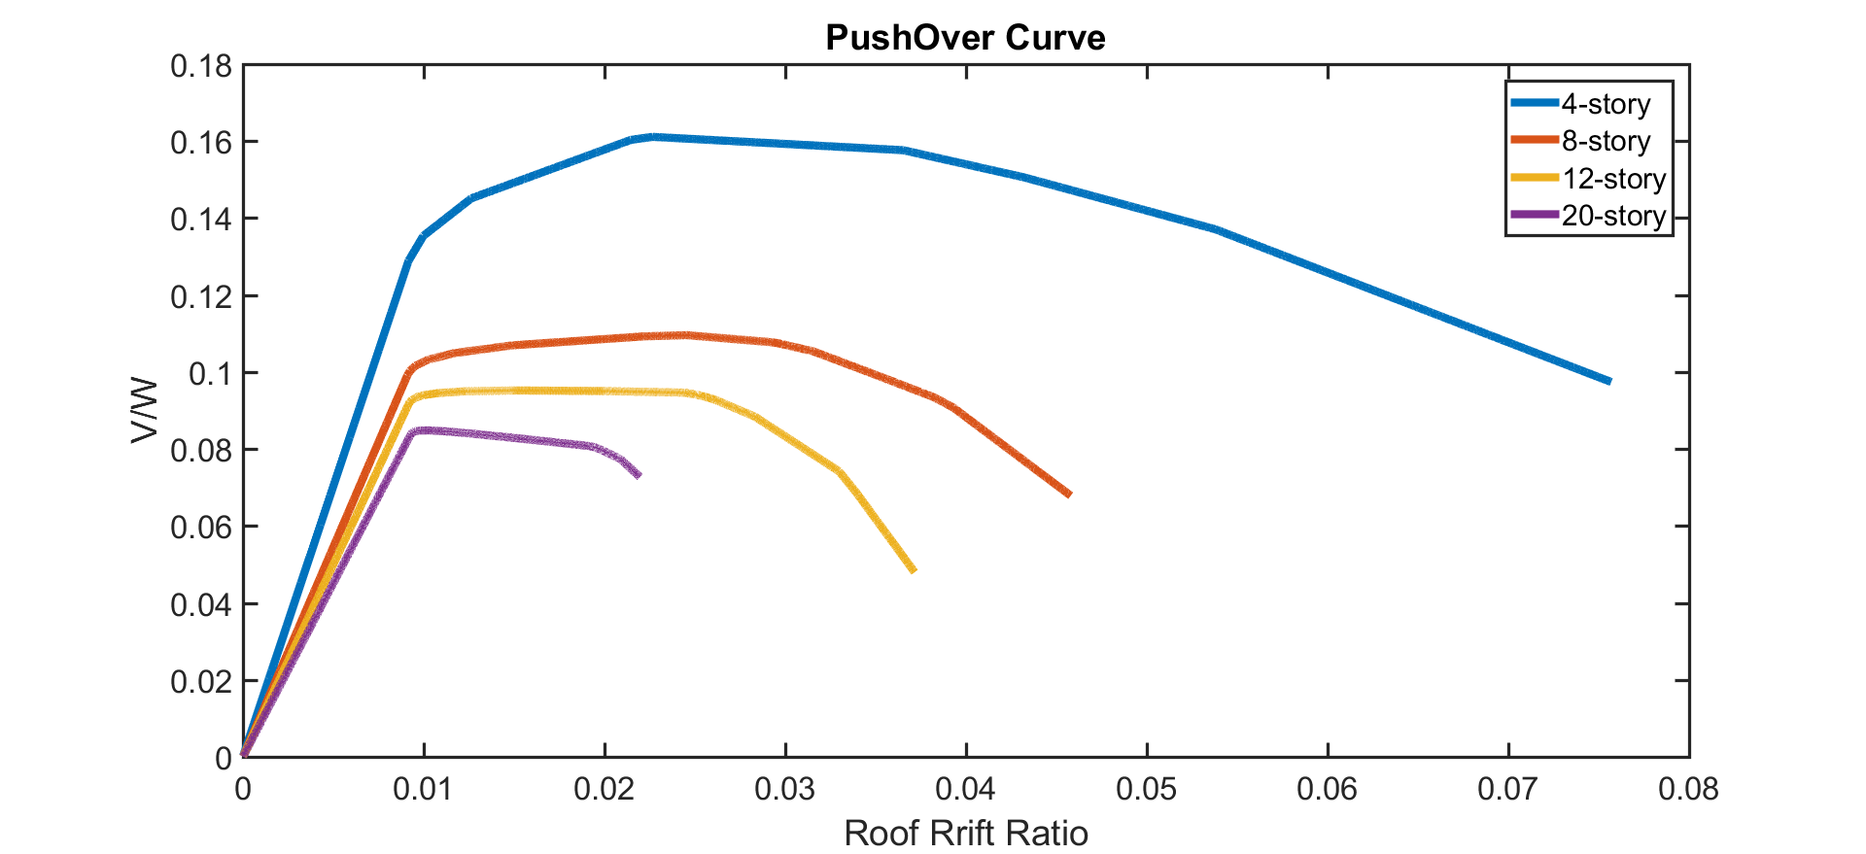
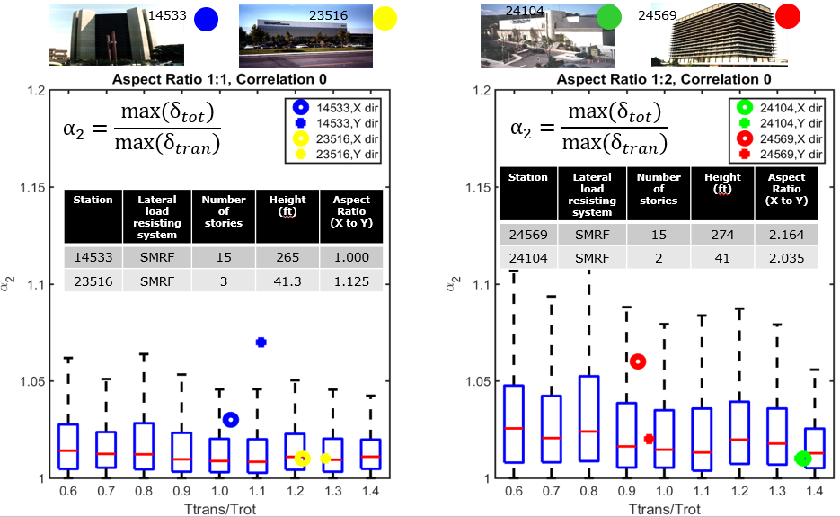
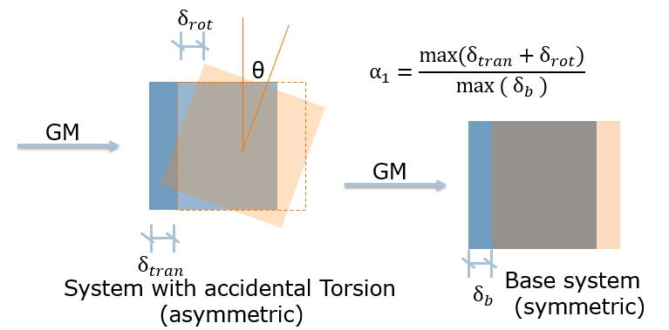
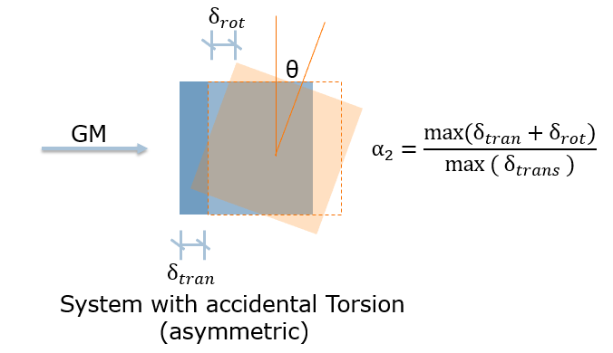
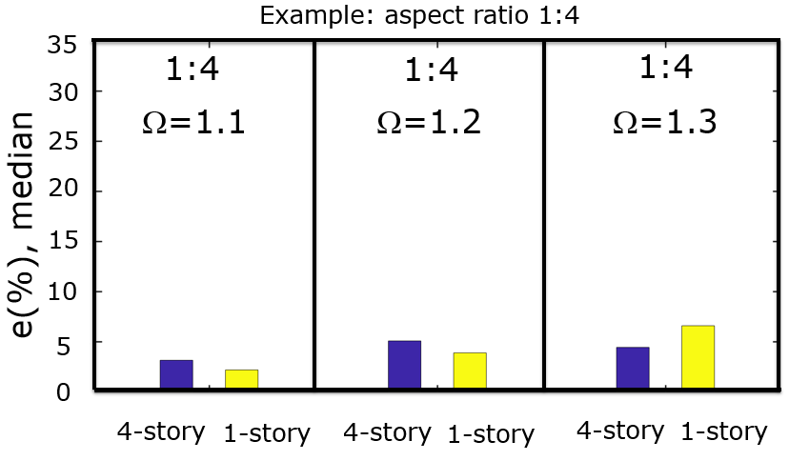
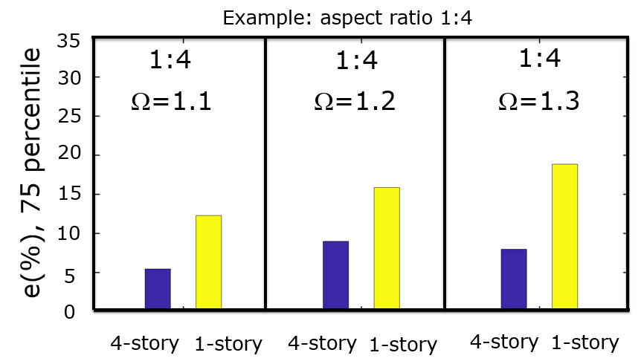
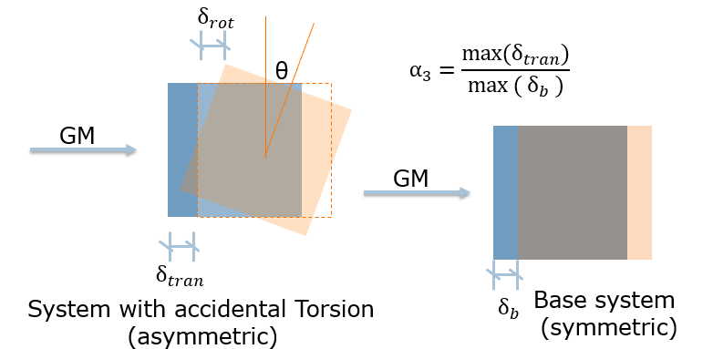
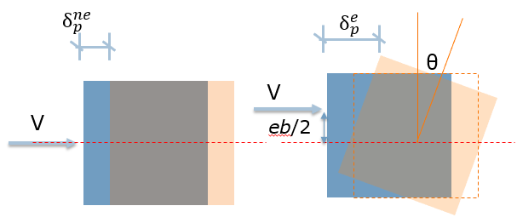
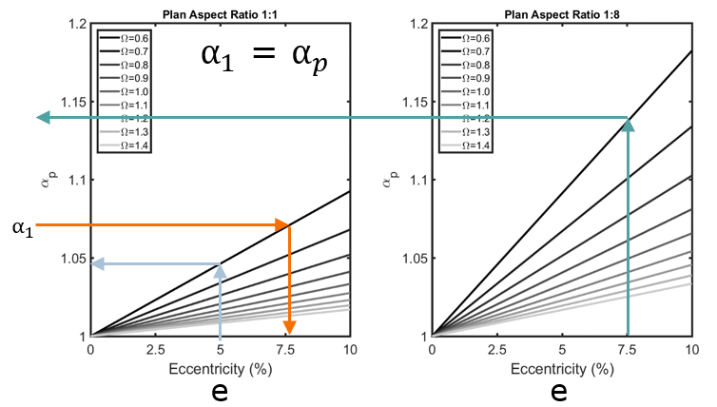
Critical Assessment of Code Torsional Provisions using CSMIP Database of Instrumented Buildings
Principal Investigator: Farzin Zareian, Farzad Naeim, UC Irvine Student Investigators: Yijun Xiang, UC Irvine Performance-Based Earthquake Engineering Laboratory, University of California Irvine
California Strong Motion Instrumentation Program (CSMIP)
Objectives
Methodology
Develop a set of rational, meaningful, and practical ways to include accidental torsion in seismic response assessment of buildings.
Characteristics that control building torsional behavior
Ratio of dominant translational period to dominant rotational period, $Ω=\frac{T_{tran}}{T_{rot}}=\frac{\sqrt{m/K_{tran}}}{\sqrt{mr^{2}/K_{rot}}}$
Improve both the seismic design provisions of building codes (e.g., ASCE, 2010, and 2007) and the practice of performance-based design and retrofit of structures.
Building aspect ratio, 1:1, 1:2, 1:4 and 1:8 are investigated.
Building height, 1-story, 4-story, 8-story, 12-story and 20-story buildings are studied.
Linear and Nonlinear Modeling
One-story four-VLLR systems with symmetric plans are modeled in OpenSees. To consider the effect of uncertainty in stiffness, stiffness of VLLRs are modeled as four random variables with c.o.v of 0.14 based on variability of element cross section dimensions. Monte Carlo simulations are adopted to access response statistics.
Results
Effect of plan aspect ratio in linear system
For nonlinear models, 2D generic frames are first modeled with bilinear materials. Stiffness of beams and columns are optimized from target dominant periods of buildings of different story numbers. Then 3-D building plans are selected based on Ω and plan aspect ratios.
Systems with plan aspect ratio of 1:1 to 1:8 and Ω ranging from 0.6 to 1.4 are investigated. Both mean response and 75th percentile response are transferred to equivalent eccentricity.
 | 4-story | 8-story | 12-story | 20-story
$$α_{T}$$ | 0.40 | 0.30 | 0.25 | 0.20
$$T_{1target}(sec)$$ | 1.6 | 2.4 | 3.0 | 4.0
Simulated data vs. CSMIP data
Four buildings with different height and aspect ratio are selected from CSMIP database, and the corresponding amplification factor $α_{2}$are calculated and compared to simulated data.
Torsional Vibration Characteristics(Displacement amplification factors)
$α_{1}$, the ratio of total response to translational response without eccentricity.
$α_{2}$, the ratio of total response to translational response in each eccentric system.
Comparison between linear and nonlinear 4-story systems
$α_{3}$, the ratio of total response with eccentricity to translational response without eccentricity.
Equivalent eccentricity, which determines how far away should the equivalent static lateral force be applied from the center of mass to make the symmetric system has as much displacement amplification as an asymmetric system has.
Conclusions
5% equivalent eccentricity is adequate to represent the 50th percentile (median) response of 1-story elastic systems and 4-story inelastic systems at all aspect ratios
targeting a higher level of confidence (more than 50th percentile) requires a larger equivalent eccentricity than 5%
The ratio of the required equivalent eccentricity for 1:1 and 1:8 aspect ratio systems is smaller than 1/8

